Slide 1
Hurricane Harvey – Track Analysis
Data Analytics & Visualization 2020

Slide 2
Project Information
Project Team (Group 6):
Reza Abasaltian, Vincent Adams, Jeremy Jones, & Rob Pascarella
Project Scope:
As a group we have decided to gather data from offshore weather stations and platforms to perform an analysis of weather attributes as they correlate to the intensity of Hurricane Harvey.
Weather attributes analyzed:
Wind Speed (m/s); as our measure of intensity
Water Salinity (PSU – practical salinity unit [g of salt in kg of seawater)
Air Pressure (mBar)
Water Temperature (°C)
Air Temperature (°C)

Slide 3
Questions
What weather attributes contributed the most, if any, to the intensity of Hurricane Harvey?
Did water temperature affect intensity of the hurricane the most?
Did air temperature affect the intensity of the hurricane the most?
Did air pressure affect the intensity of the hurricane the most?
Did water salinity affect the intensity of the hurricane the most?
How will this problem be attacked?
Graphically, we will represent our data in scatter plots to show correlations as well as box plots to show our outliers in within each data set.
Statistically speaking, correlation coefficient and p-value will be used to assess each attributes relativity to wind speed, our standard for hurricane intensity.
Notably, as the project grew, several more data sources were found that would provide very interesting insight,

Slide 4
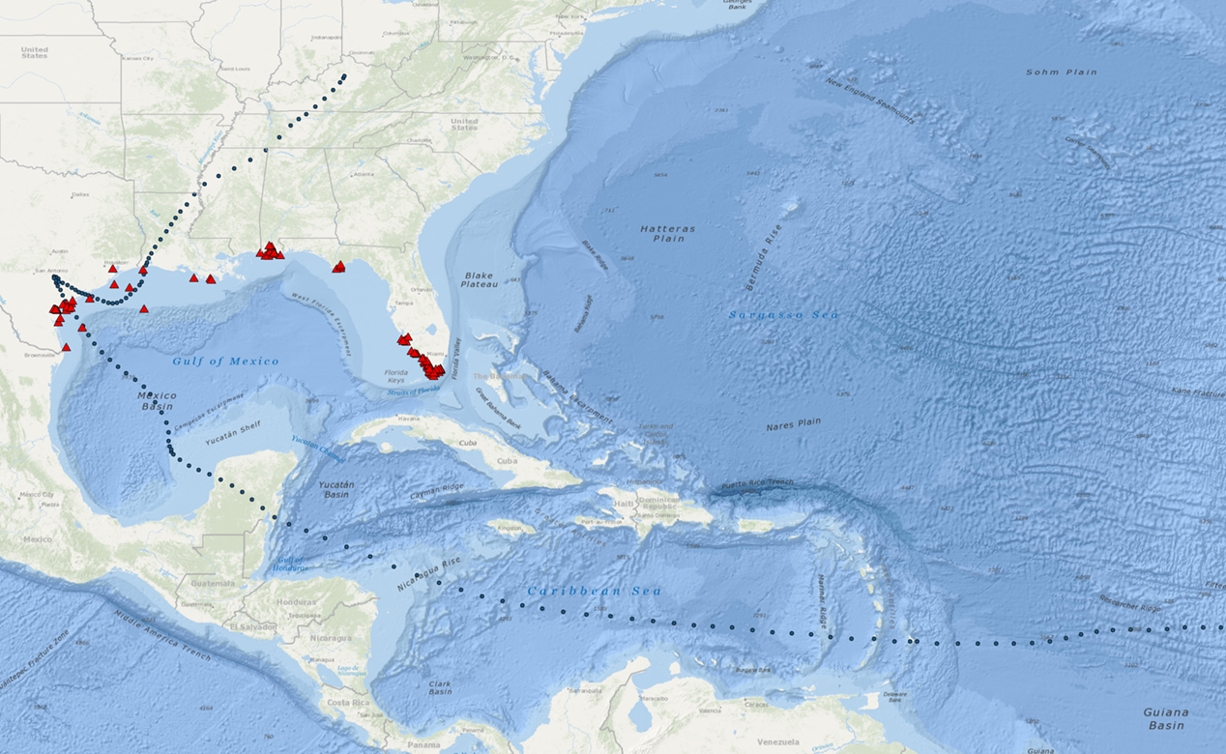
Project Data Sources
Data Retrieval
.csv data:
Gulf of Mexico Coastal Ocean Observing System
http://data.gcoos.org/waf.php
National Hurricane Center
https://www.nhc.noaa.gov/data/tcr/AL092017_Harvey.pdf
-Utilized data, created a csv for Harvey track
API:
GMaps
https://cloud.google.com/maps-platform/
Hurricane Harvey caused unprecedented flooding in the gulf – tied only with the likes of Katrina in terms of $125+billion in damage. Unbeknownst to many, it weakened and strengthened many times until finally becoming the largest tropical storm in a 12-year span (2005) to make landfall in the United States.

Slide 5
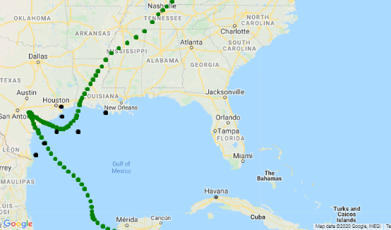
Project Data Point Locations
Selected Data Points:
A = 42043
B = 42044
C = 42047
D = 8764314
E = 8770613
F = TABS-X
G = 42019
E
A
D
G
C
F
B

Slide 6
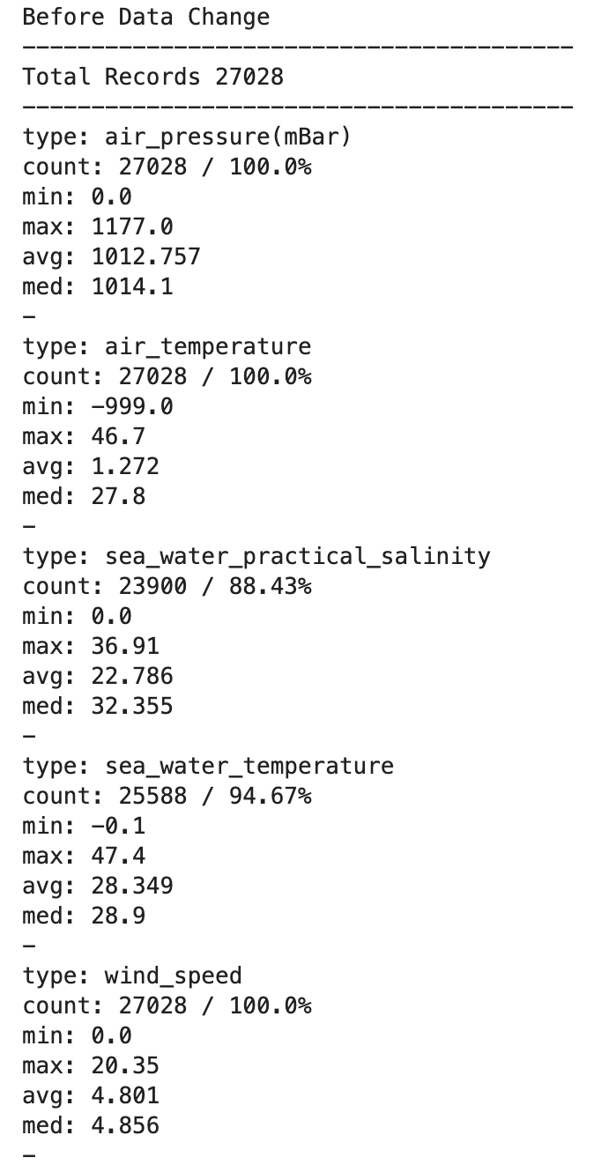
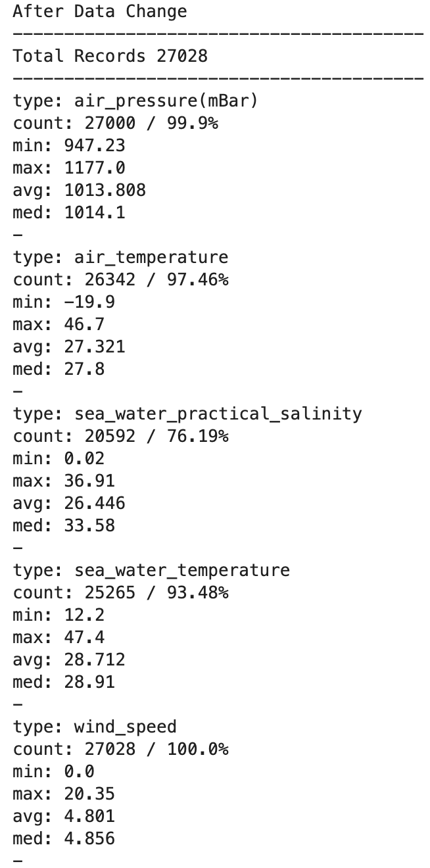
Data Cleanup
Wind Speed was considered dependent variable.
Salinity, Air and Water Temperature, Air Pressure are the independent variables.
After the data was scrubbed, it can be shown that a large portion of the data was salvaged for utilization in harvesting analysis.
Notice the difference in the average and the median.
All .csv files were combined using an outside join technique, keying on the date/time collected.
The data was examined for continuity:
It was noticed that there were several gaps that were solved by nulling these areas.

Slide 7
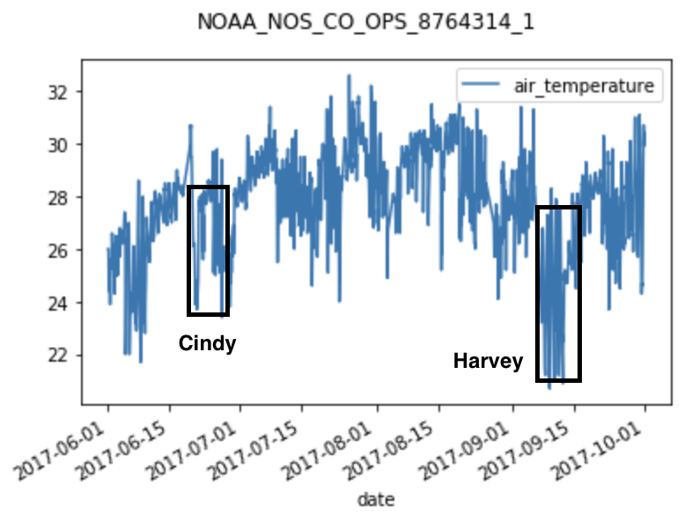
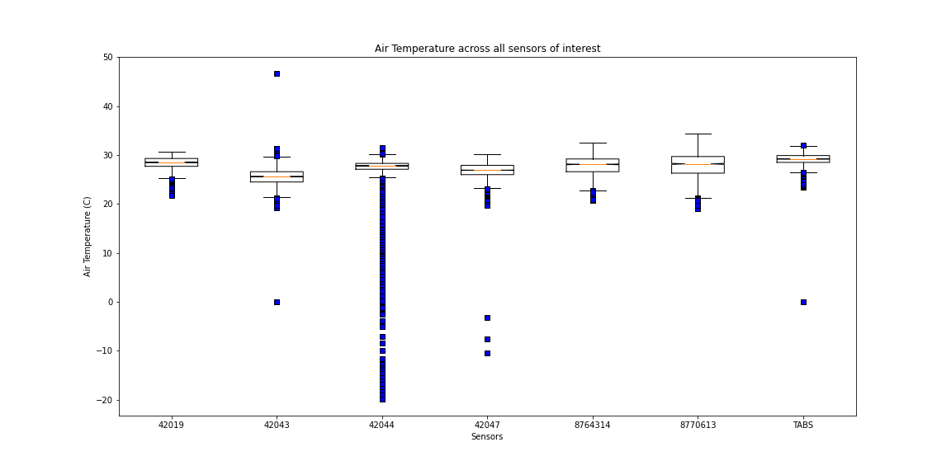
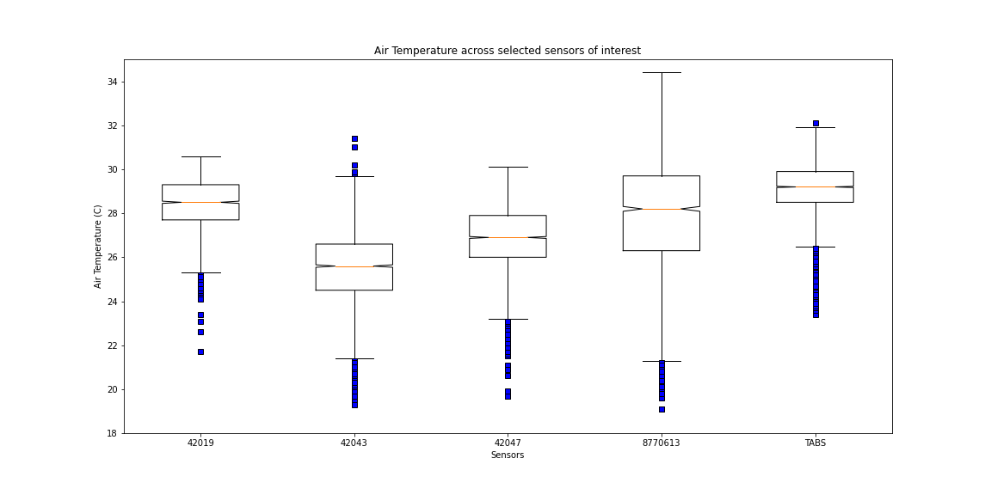
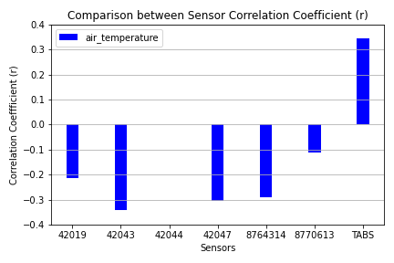
Air Temperature
Data Outliers
8764314
42044
42047
Remaining Sensors
p_{TABS-X}=5.633e-160

Slide 8
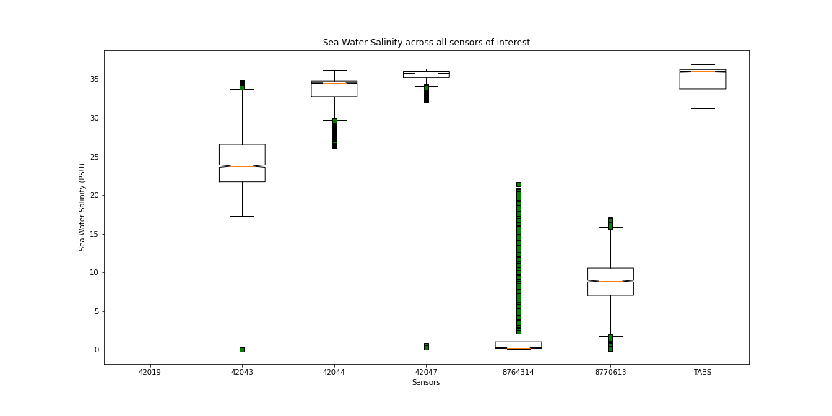
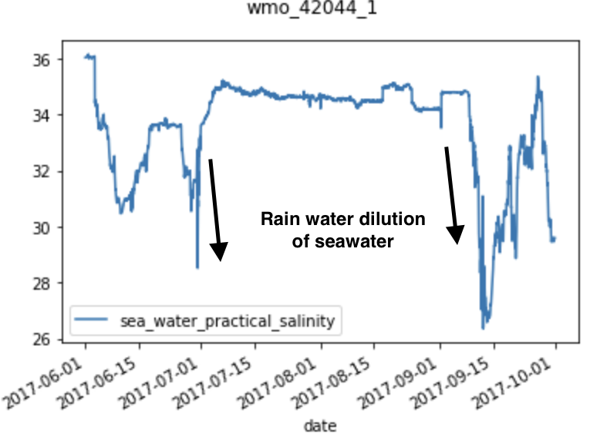
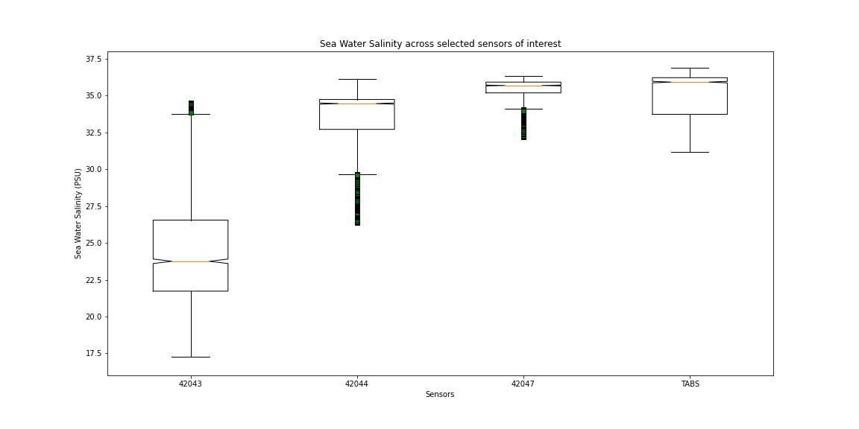
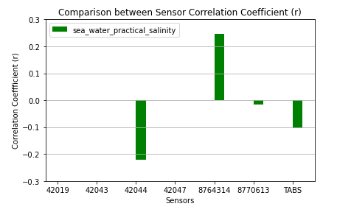
Water Salinity
Data Outliers
42044
42047
8764314
Remaining Sensors
p₄₂₀₄₄=1.253e-65

Slide 9
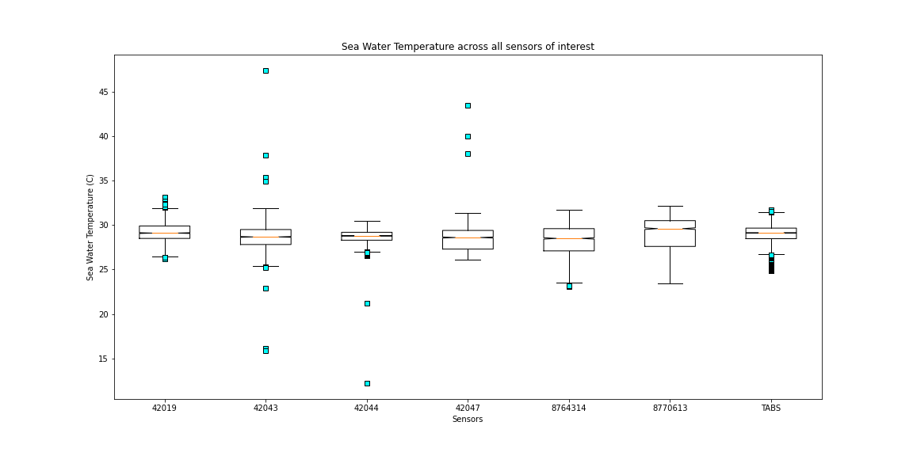
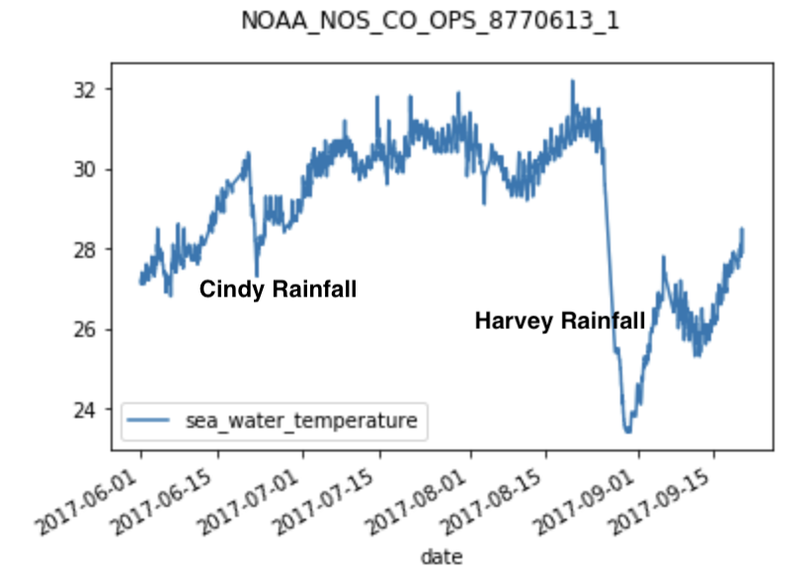
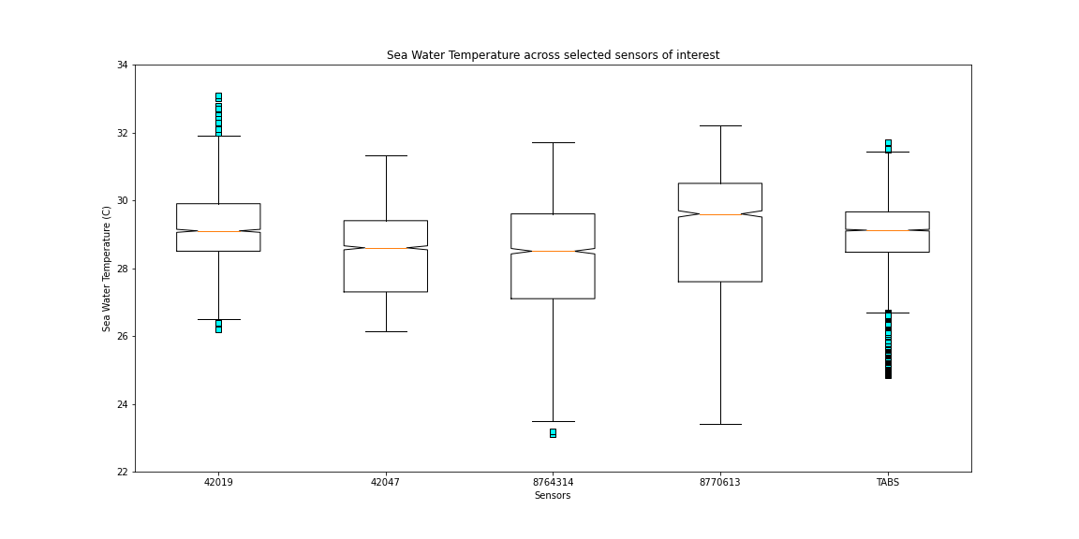
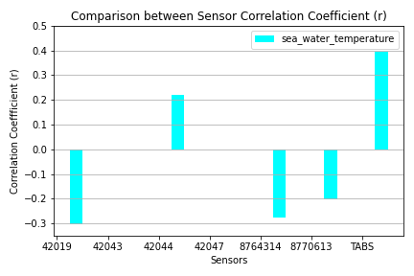
Water Temperature
Data Outliers
8770613
42043
42044
Remaining Sensors
p_{TABS-X}=1.15216e-214

Slide 10
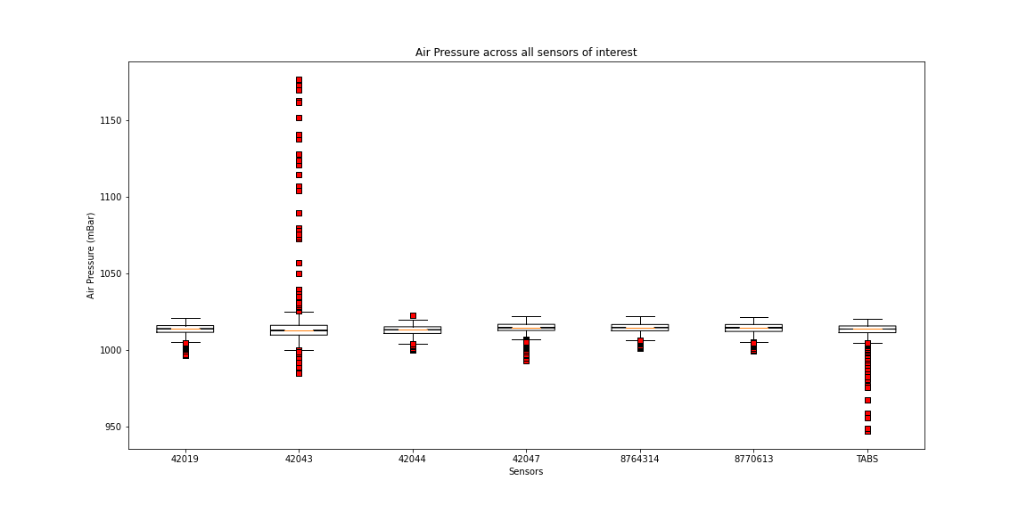
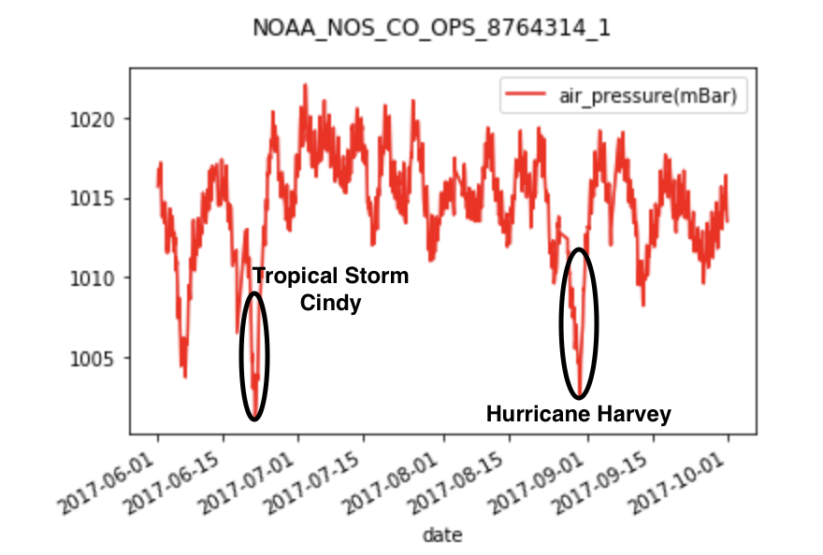
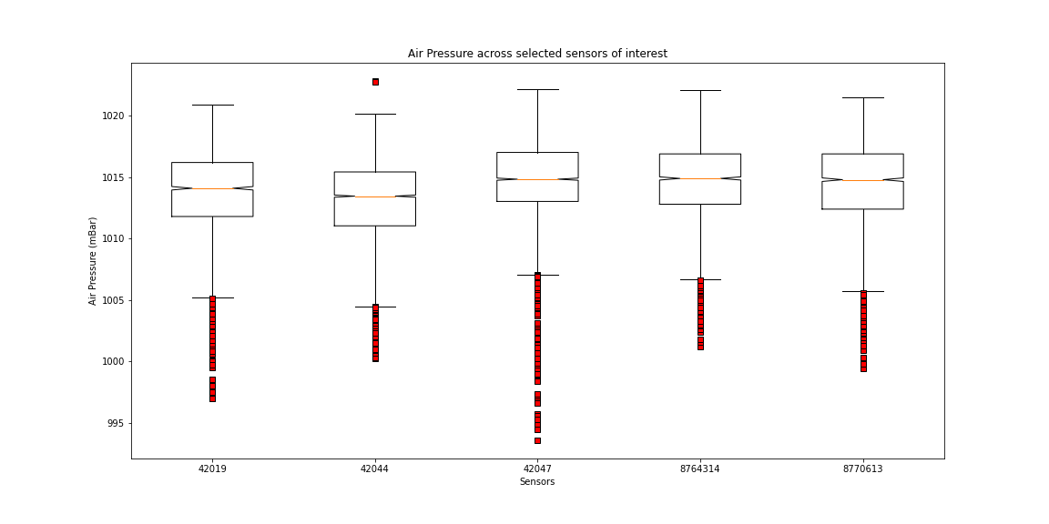
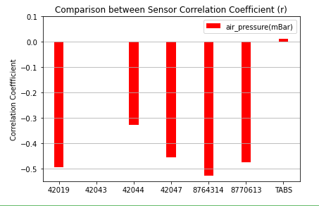
Air Pressure
Data Outliers
8764314
42047
TABS
Remaining Sensors
p₄₂₀₄₇=6.074e-248

Slide 11
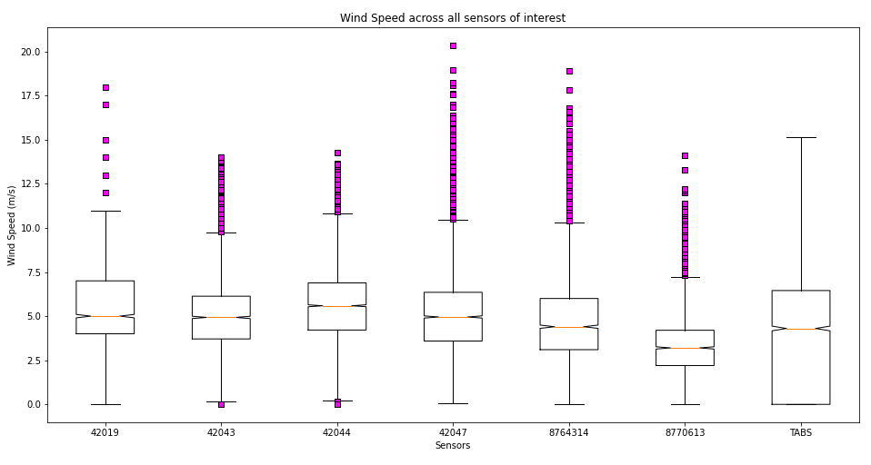
Wind Speed
In the case of wind speed, we do NOT want to ignore outliers. The outliers (higher wind speed) as they would relate to the remaining data would in fact be the hurricane strength speeds.

Slide 12
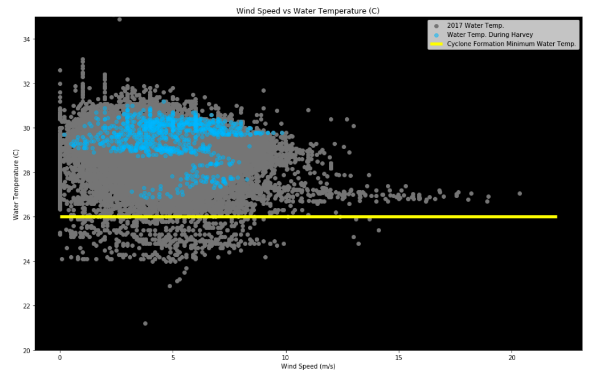
Water Temperature Firefly
As stated, the correlation and p-value tests were the driving factor for the analysis. The grey data here shows the population of water temperatures recorded over the entire summer. The blue dates highlight the timeframe that was recorded in the several days leading up to Harvey landfall.
The yellow line was installed for reference.
Through meteorological research, it has been noted that the strongest storms typically occur with water temps over 26°C – note that all of the data prior to Harvey landfall is above the “go/ no-go” line.

Slide 13
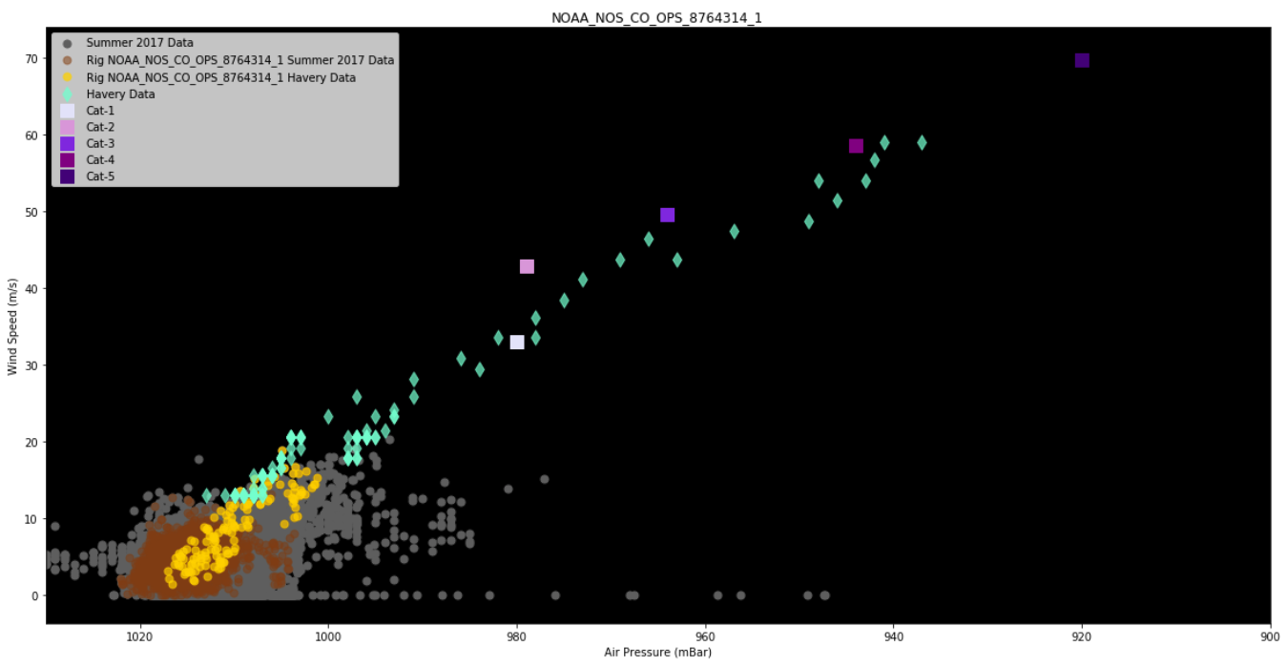
Air Pressure Firefly
Per our data acquisition, Air Pressure showed the greatest correlation to rising wind speeds. The grey area here, as before, shows the population data for the entire summer data set. The brown and yellow show August and hurricane specific data that we would have expected to trend with rising wind speed.
The green “Harvey Data” was acquired via National Hurricane Center –
This completely overlays the expected speed vs. Air Pressure relationship.

Slide 14
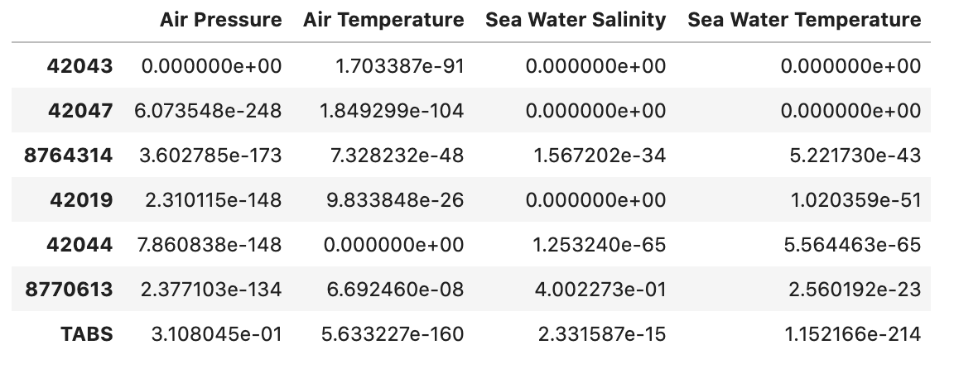
Complete P-Value Data
This slide included for reference data detailing the statistical analysis. The main deciding factor is the correlation coefficient. These p-values support the significance of that attribute as it relates to hurricane strength (wind speed).
Complete P-Value Results

Slide 15
Limitations
As is typical for a data project, the group was at the mercy of the available data. Only certain platforms/weather stations acquired the points useful that were necessary for analysis that lie in a vicinity of the path of the storm.
Even as useable sites were located, as the project progressed, it was found that there were several levels of incompleteness regarding the gathered data sets. For example:
Inconsistency of sensor data acquisition by location and time.
Sensor calibration.
Missing data.
Erroneous data on some of the data sets collected during the actual Hurricane.
Several instances of incomplete data during the storm (platform down or damaged).
Specifically, salinity and wind speeds were incomplete.

Slide 16
Conclusions
Conclusive evidence presented itself as result of the correlation and p-value testing. Air Pressure mathematically related to windspeed inversely with the most significance.
The null hypothesis that sea water temperature would effect the hurricane intensity the most was disproven by these tests. However, we did see many expected correlations.
The Air Pressure Firefly diagram points out some interesting data. The actual wind speeds collected for the plotted location during the timeframe of the hurricane are actually quite low, although elevated from the bulk of the summer data collected. The sonar data does overlay expectedly for hurricane force winds at the lower pressure levels.
Another interesting Sea Water Firefly showed that, as expected, water temperatures in the days just before landfall of Harvey are indeed vastly above the “elevated risk” levels for hurricane development as put forth by meteorological study.
Test results 0 = no correlation, no significance, and/or no data. We would have enjoyed gathering more intel on these locations/attributes.

Slide 17
Continued Analysis
Weather data is rarely complete. Solid lessons were learned in the realm of cleaning, using what is actually available/tangible data, searching for supporting documentation, and creating a minimum viable deliverable before spending extra time on completeness.
Interesting analysis could continue with extra effort and time:
Using regression studies to compare historical data/seasonality to the Harvey-specific data
Continue to slice and study segments of data via K-means clustering. Centroid results could present some interesting divergences.
Revisit the incomplete data; use extra resources; extend analysis.
Add new measurements of intensity such as size or development speed of the hurricane for an extra dimension.

Slide 18

Questions
Thank you for your time and attention!
Questions, please!?

Slide 19
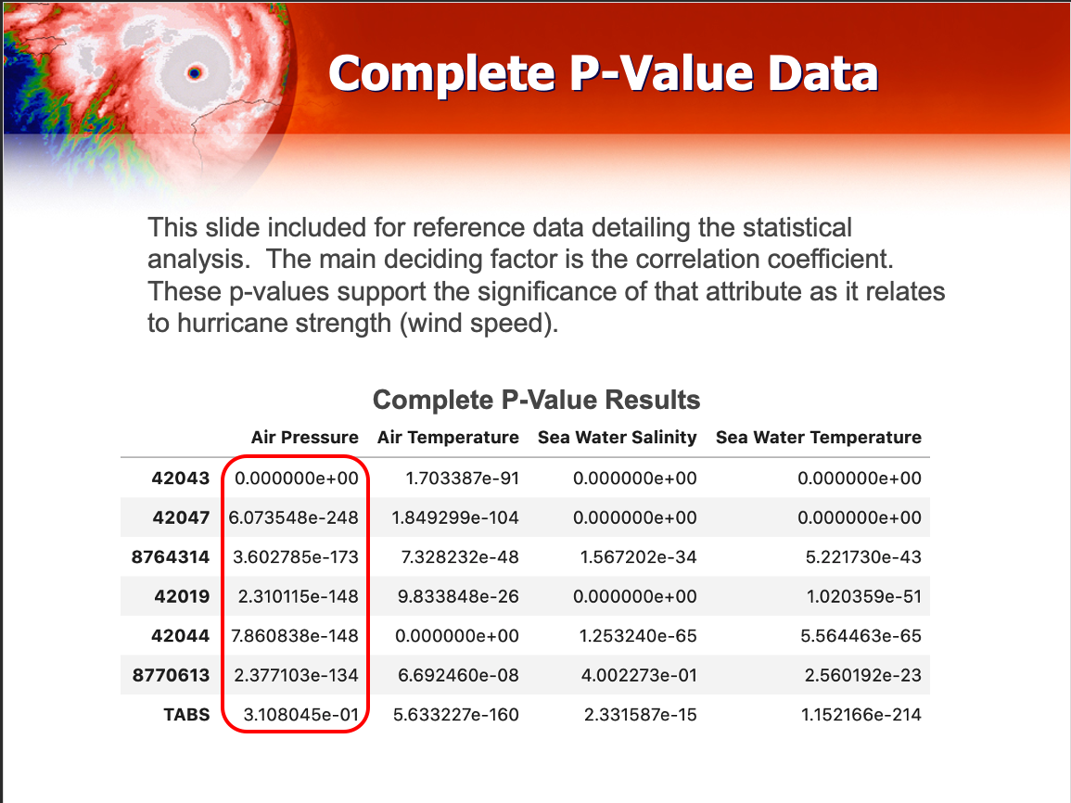
All the sensors

